Slide 1
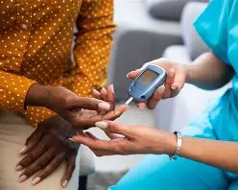
Diabetes prediction
Zahra Rezaee

Slide 2
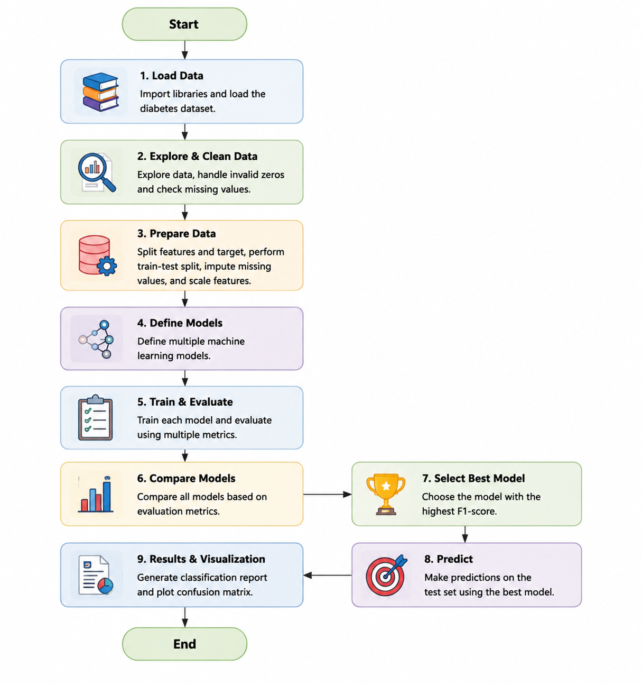

Slide 3
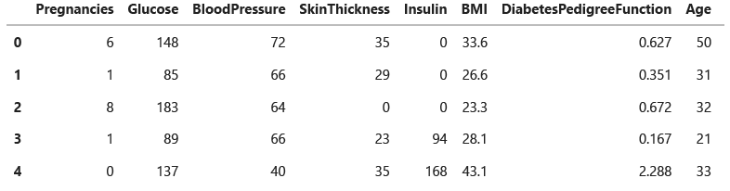
Load Data
Dataset: Pima Indians Diabetes Dataset
Loaded using Pandas
File format: CSV (diabetes.csv)
Data stored in a DataFrame
Ready for preprocessing and analysis

Slide 4
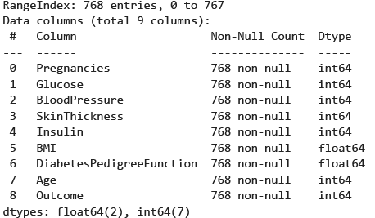
Explore & Clean Data
Explored the dataset using:
df.head()
df.info()
df.describe()
(2Identified medically invalid zero values
(3Replaced invalid zeros with NaN
Glucose
BloodPressure
SkinThickness
Insulin
BMI
(4Prepared data for missing value imputation

Slide 5
Prepare Data
Raw Data
Split (80/20)
Median Imputation
Standard Scaling
Ready for Training

Slide 6
Define Models
Logistic Regression
Decision Tree
Random Forest
KNN
SVM
Performance Comparison

Slide 7
Train & Evaluate
Training Data
Train Models
Predictions
Accuracy | Precision | Recall | F1-score

Slide 8
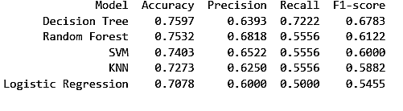
Compare Model Performance

Slide 9
Results & Visualization

Slide 10

Gold Analysis Agent
Zahra Rezaee

Slide 11
هدف پروژه
داده واقعی بازار
2
دریافت سوال کاربر
1
پاسخ هوشمند
4
تحلیل اخبار روز
3

Slide 12
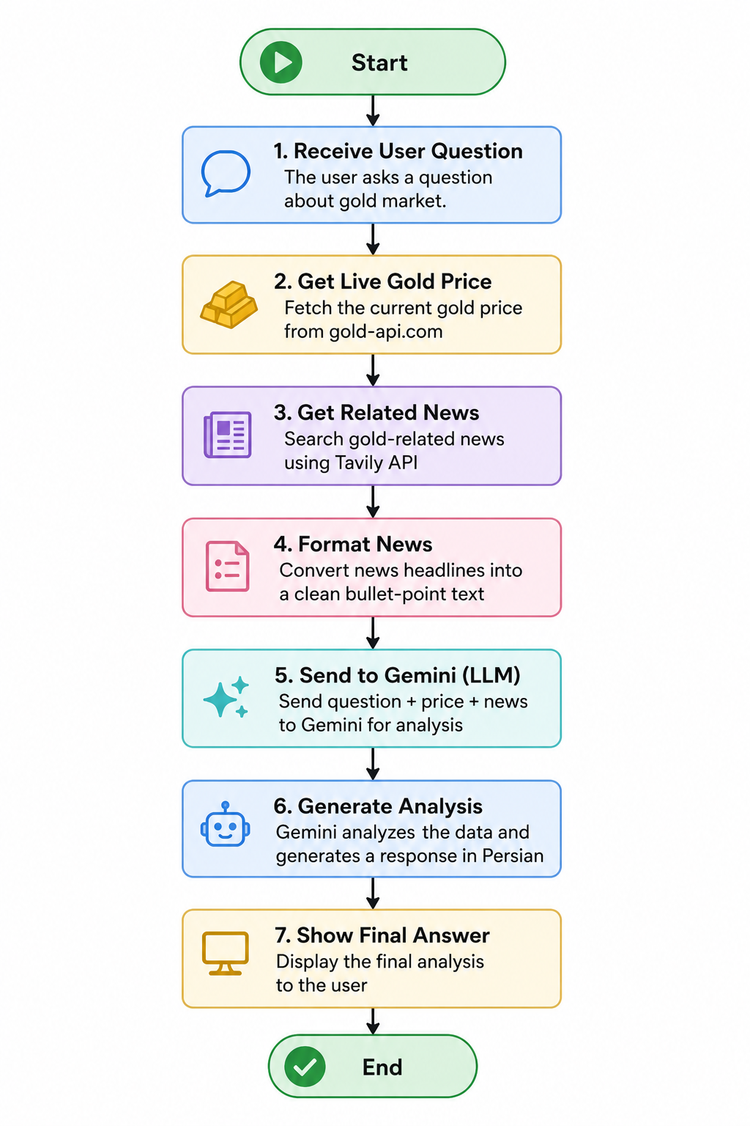

Slide 13
Receive User Question
The agent starts by receiving a user question about the gold market.
The question is passed to the main function:
run_agent(question)
Example user questions:
What is the current gold price?
What is the gold trend for next week?
Is now a good time to buy gold?
What are today’s important gold news?
This step defines what the agent should analyze.

Slide 14
Get Live Gold Price
gold = yf.Ticker("GC=F")
data = gold.history(period="5d", interval="1d")
current_price = round(float(data["Close"].iloc[-1]), 2)

Slide 15
Get Related News
Gold market news
Federal Reserve
US interest rate
US inflation
DXY (Dollar Index)
Geopolitical tensions

Slide 16
Format News
The news results are returned as a list from Tavily.
This step converts the news list into a clean bullet-point text.
Only the news titles are extracted.
The formatted news text is later added to the Gemini prompt.
Output Example
Gold rises after Federal Reserve comments
Inflation data affects gold market expectations
U.S. dollar movement influences gold prices

Slide 17
Send to Gemini (LLM)
Prompt Includes
User question
Gold futures price from Yahoo Finance
Gold-related news headlines from Tavily
Rules for the model:
Use only the provided data
Mention limitations if data is missing
Do not give definitive financial advice
Write the answer in Persian

Slide 18
Generate analysis
After sending the prompt, Gemini generates the final response.
The model analyzes:
Gold price
Financial news
User question
It produces a natural language explanation of the gold market.
The output is returned to the user in Persian.

Slide 19
Show Final Answer
============================================================
سوال: فعلی طلا:**قیمت فعلی طلا چقدر است؟
------------------------------------------------------------
**قیمت
قیمت آتی فعلی طلا 4187.3 دلار آمریکا به ازای هر اونس تروی است.
**تحلیل روند بازار:**
….
**محدودیت‌های تحلیل:**
....
**تذکر:** این تحلیل صرفاً بر اساس داده‌های ارائه شده است و نباید به عنوان توصیه مالی برای خرید یا فروش طلا تلقی شود. تصمیمات سرمایه‌گذاری باید با مشورت متخصص مالی و تحقیقات کامل انجام شود.

